Slide 1

Department of Information Technology
NBA Accredited A.P. Shah Institute of Technology G.B.Road,Kasarvadavli, Thane(W), Mumbai-400615 UNIVERSITY OF MUMBAI Academic Year 2021-2022

Slide 2
A Project Presentation on Real Time Crop Recommendation
Submitted in partial fulfillment of the degree of Bachelor of Engineering(Sem-6) in INFORMATION TECHNOLOGY By Ishika Sharma(19104061) Ruta Mhaskar(19104013) Anagha Rai(19104030) Under the Guidance of
Prof. Kiran Deshpande
Name of Guide:
Prof. Charul Singh
Prof. Sonal Jain

Slide 3
1.Project Conception and Initiation

Slide 4
1 Introduction:
Farming is one of the major sectors that influences a country’s economic growth.
In country like India, majority of the population is dependent on agriculture for their livelihood. Many new technologies, such as Machine Learning ,are being implemented into agriculture so that it is easier for farmers to grow and maximize their yield.
In our project, we are implementing Crop Recommendation System.
In this application, the user can provide the soil data from their side and the application will predict which crop should the user grow.

Slide 5
1.1 Objectives
To give right knowledge to the users about which crop to sow in their field based on the soil data.
To recommend optimum crops to be cultivated by farmers based on several parameters and help them make an informed decision before cultivation.
To develop a user-friendly website.

Slide 6
1.2 Literature Review
In this literature survey of the project, the team studied various sites mentioned in the reference section.
The dataset entries required for this project were referred from [1].
Flask is a Python-based microframework used for developing small scale websites. Reference [2] talks about it's usage. The prerequisites for this include installing required libraries, fetching dataset, pre-processing it, using appropriate ML algorithm and training and testing the accuracy of the model.
The overall study of the problem statement and existing solution to it was studied from [3]

Slide 7
1.3 Problem Definition
India is known as the land of farmers and agriculture is carried out over acres.
Most of the farmers lack information about the crops to be cultivated in different regions.
Hence they end up growing the wrong crop.
This results in mass deduction of food produce.
Solution:
As a solution to this problem, this project focuses on studying the soil type and suggesting the right crop for it.
The ML algorithm used takes input from the user and displays the best crop match.

Slide 8
1.4 Scope
Can be used by farmers to know the right type of crops to grow in their fields.
Can become the go-to assistant that recommends the optimum crop for a soil type.

Slide 9
1.5 Technology stack
Frontend - HTML, CSS.
Framework - Flask
ML using python.

Slide 10
2. Project Design

Slide 11
2.1 Proposed System
The website is designed to help the farmers to decide the crops to be cultivated in a particular region by using soil data.
Thus our work will help the farmers in sowing right seed based on soil requirements to increase productivity and acquire profit.
The model which is trained with the training data set is tested with inputs from the user in our application.
The scripting done will respond to any test case predicting a crop. If the test case doesn’t match any of the predictions then a try again output is generated.

Slide 12
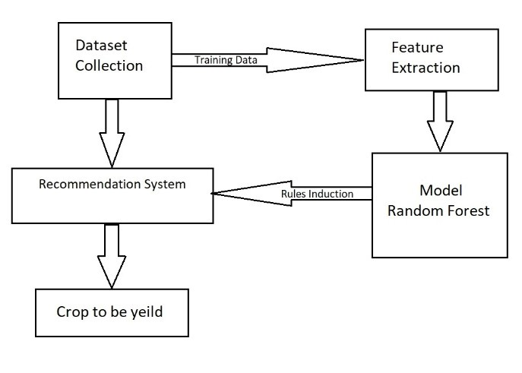
2.2 Design(Flow Of Modules)

Slide 13
3. Implementation

Slide 14
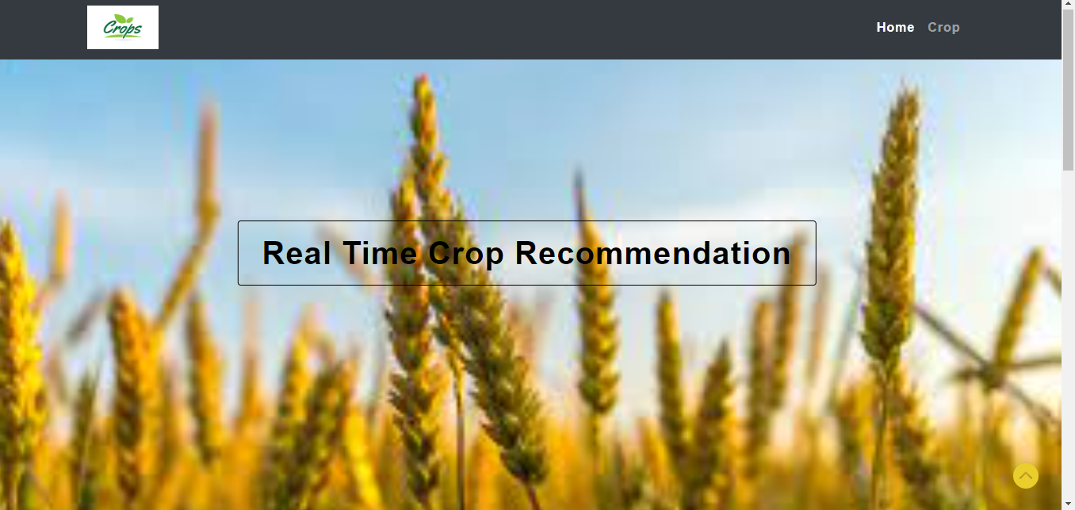
Home Page

Slide 15
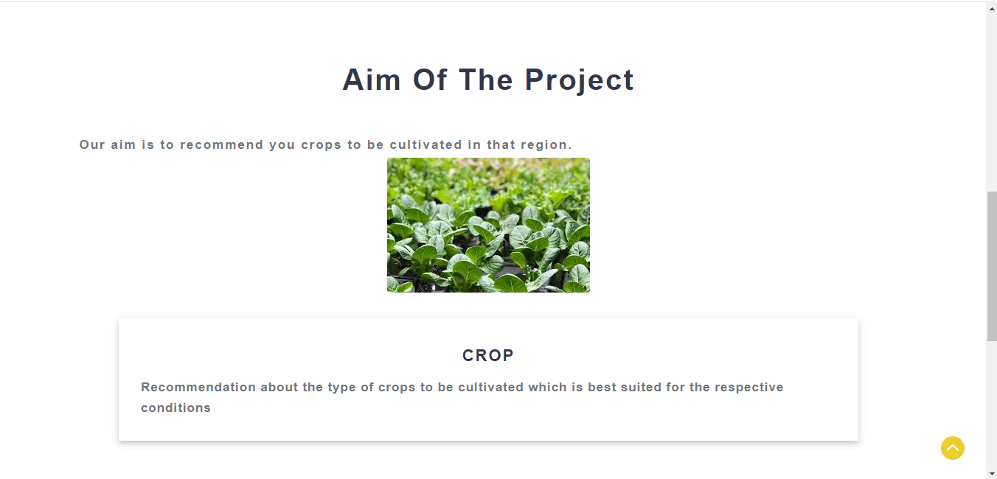

Slide 16
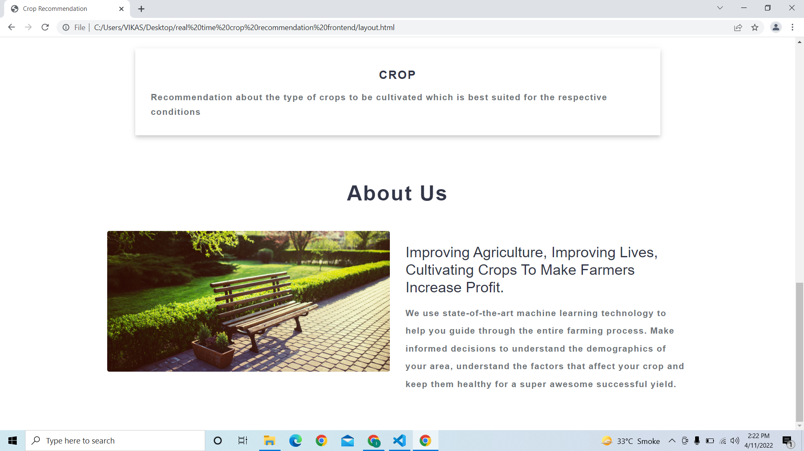

Slide 17
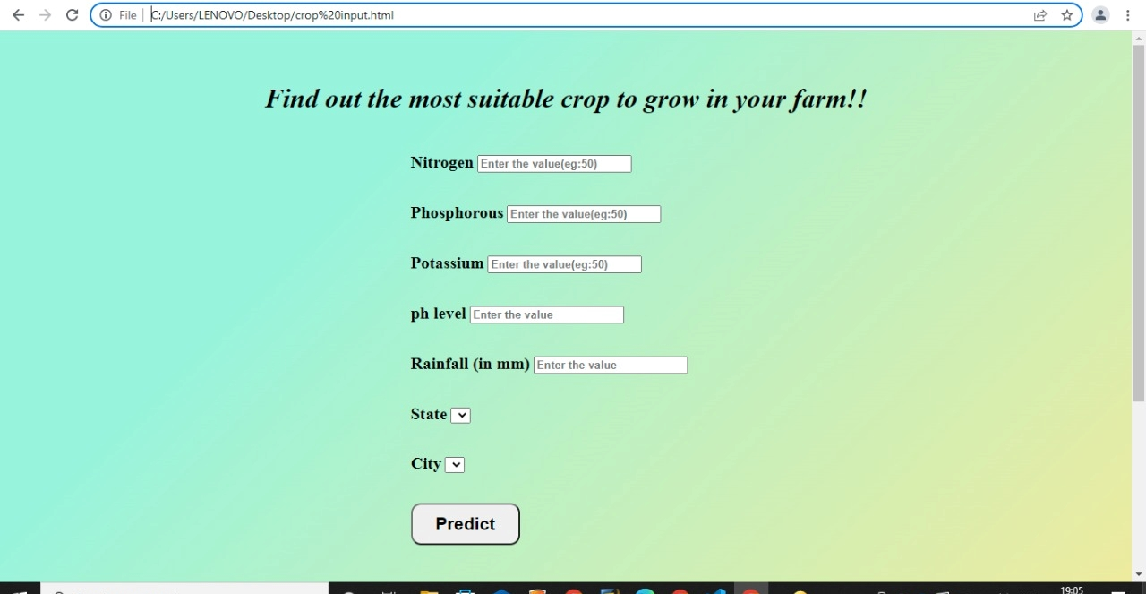
Crop Prediction Page

Slide 18
5. Result
The prediction accuracy of the model accounts to 99%.

Slide 19
6. Conclusion and Future Scope
In modern environment with less knowledge of agriculture, it is important to have knowledge and an understanding of the factors that affect the cultivation before selecting any crop. From this system, the above mentioned factors are processed.

Slide 20
References
https://www.kaggle.com/
https://www.geeksforgeeks.org/deploy-machine-learning-model-using-flask/
https://www.researchgate.net/publication/346627389_Crop_Recommendation_System

Slide 21
Thank You

